Slide 1
Simply Fly-Air Ticket Booking
Team members:
Sarvesh
Sasidhar
Mentor:
Javeed Mohammed Husnuddin

Slide 2
Introduction
Problem Statement
The Online Air Ticket Booking System is a web-based application that allows users to search for Air routes, view schedules, book tickets, and make payments online. It connects passengers with Flight owners, simplifying the process of reserving Flight seats, planning journeys, and managing bookings.
Technologies
Frontend: Angular, HTML, CSS, Bootstrap.
Backend: Java, Spring Boot
Database: MySql
Authentication: JSON Web Tokens (JWT) for secure user authentication.

Slide 3
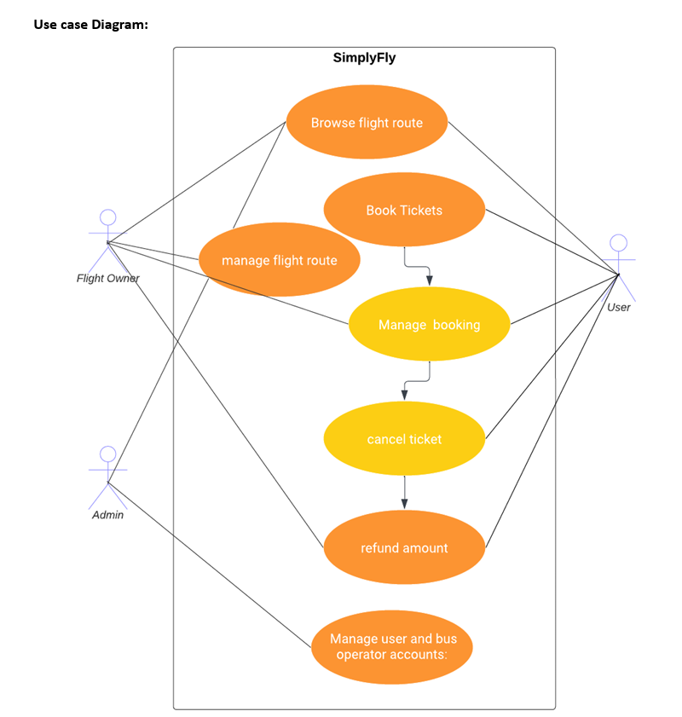
USE CASE DIAGRAM
Three Major Roles :
Admin
Flight Owner
Customer

Slide 4
Modules
Actor: User
Use Case: User Registration and login.
Use Case: Search flights.
Use Case: Select Seats and Make Reservation.
Use Case: Payment Processing.
Use Case: Cancel Tickets.
Use Case: View booking history.
Actor: Flight Owner
Use Case: Log In as flight owner.
Use Case: Manage the flight.
Use Case: Manage Bookings.
Use Case: Logout.

Slide 5
Modules
Actor: Administrator
Use Case: Log In.
Use Case: User Management.
Use Case: Manage flight Owner.
Use Case: Manage Bookings.
Use Case: Manage Routes.
Use Case: Logout.

Slide 6
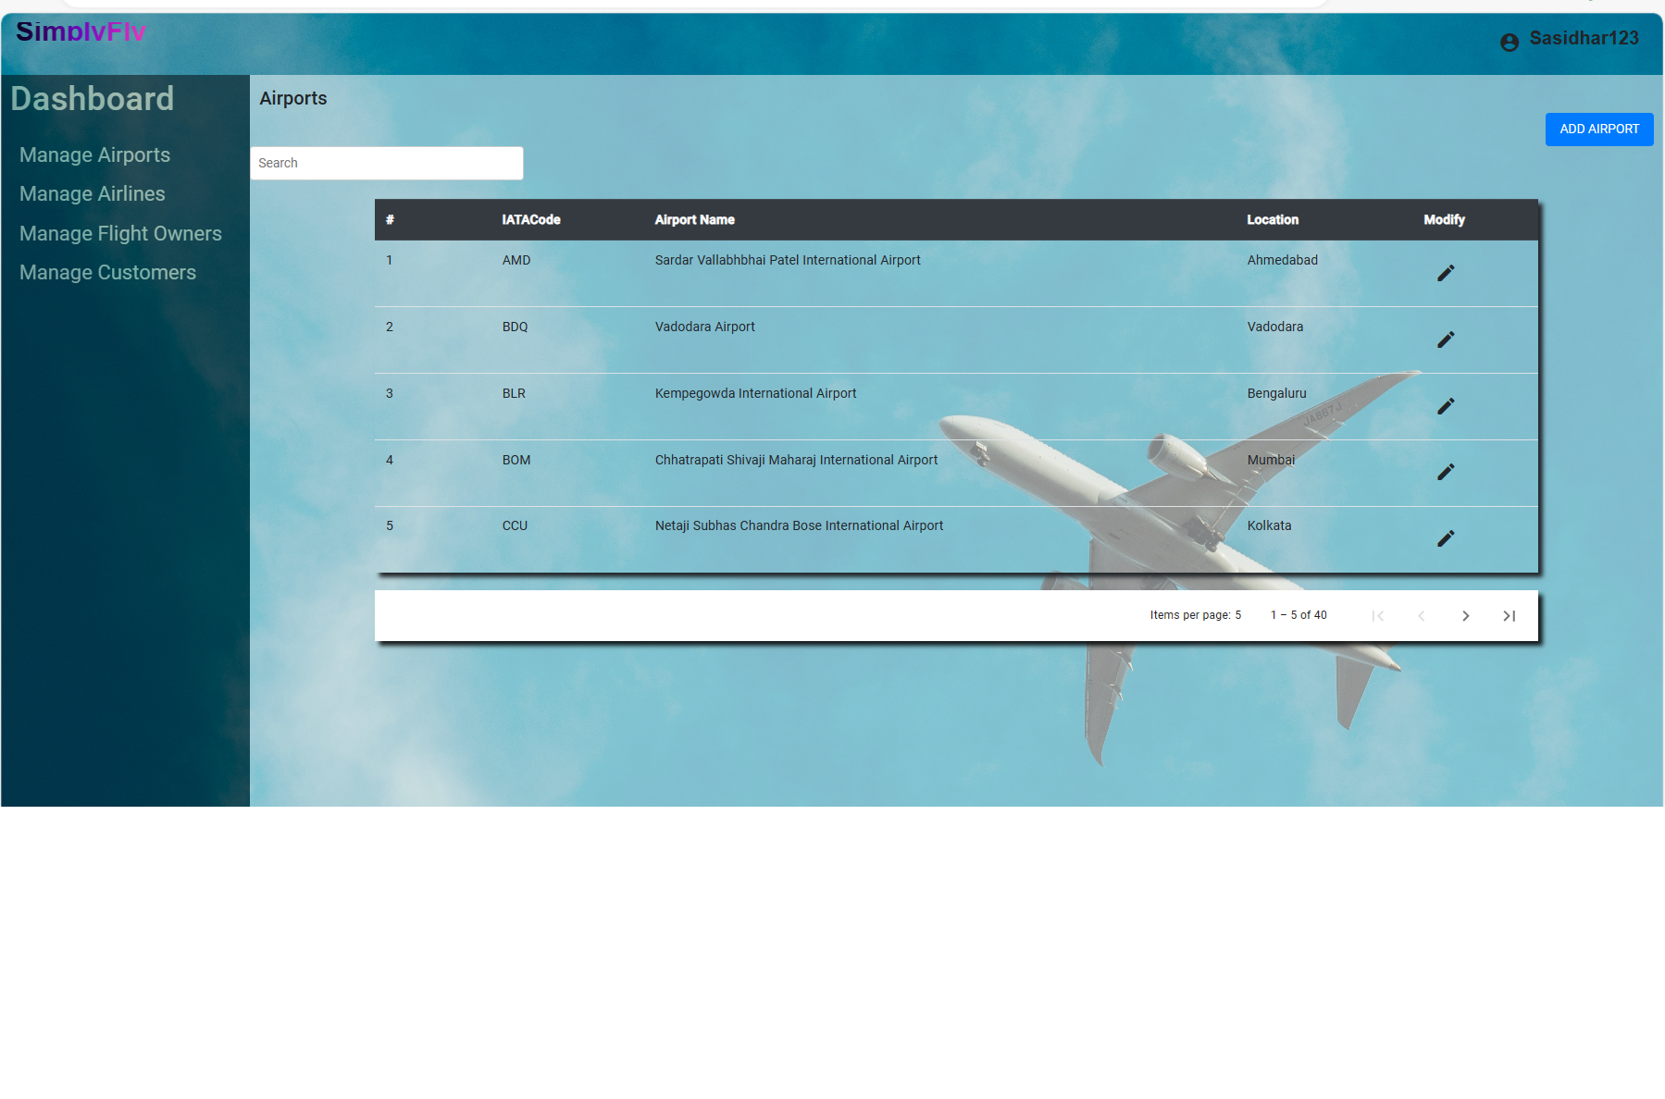
Admin Dashboard

Slide 7
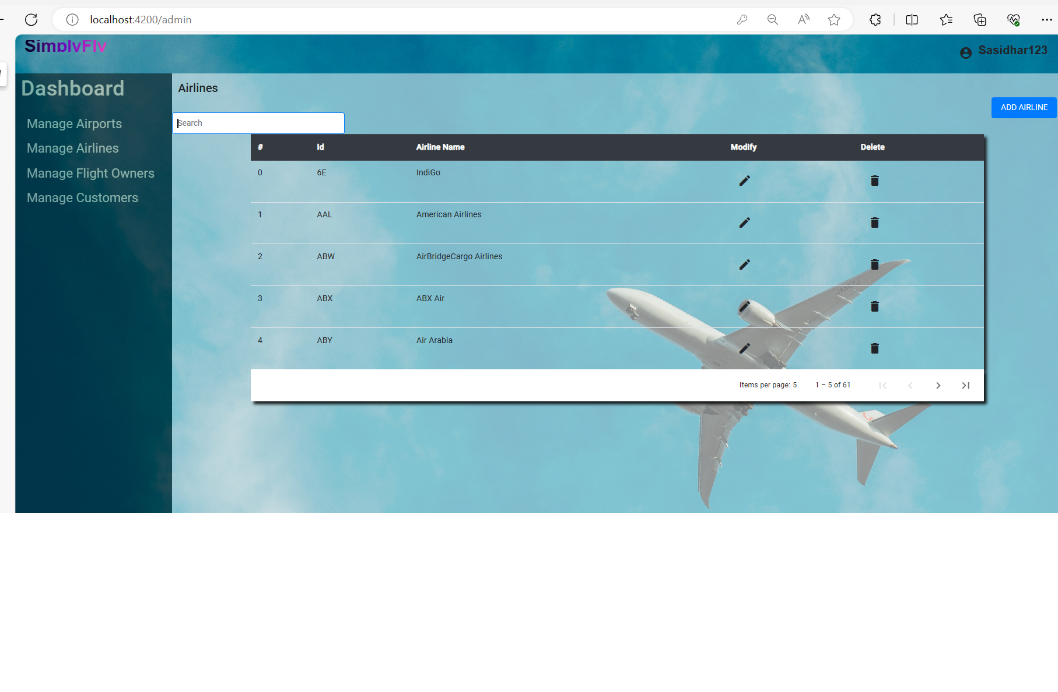
Admin Dashboard

Slide 8
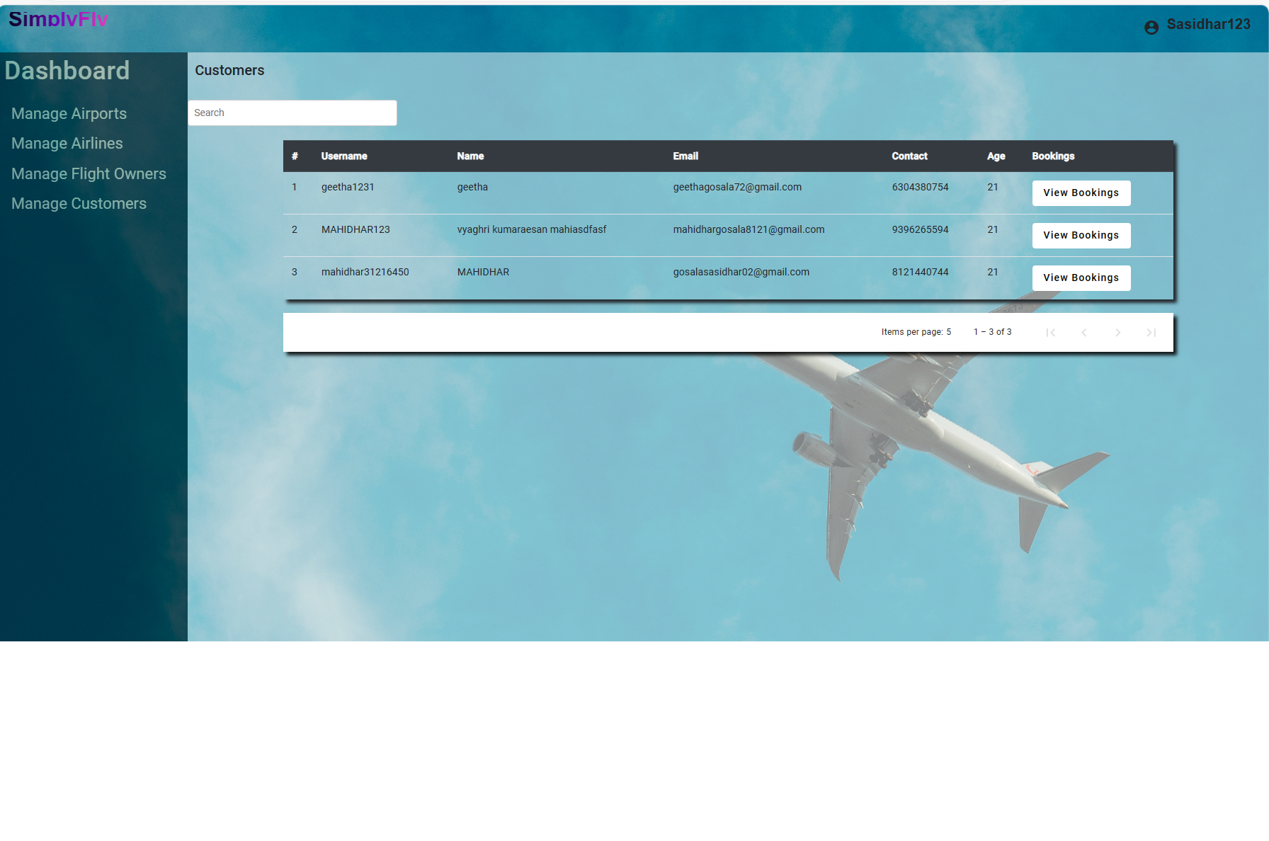
Admin Dashboard

Slide 9
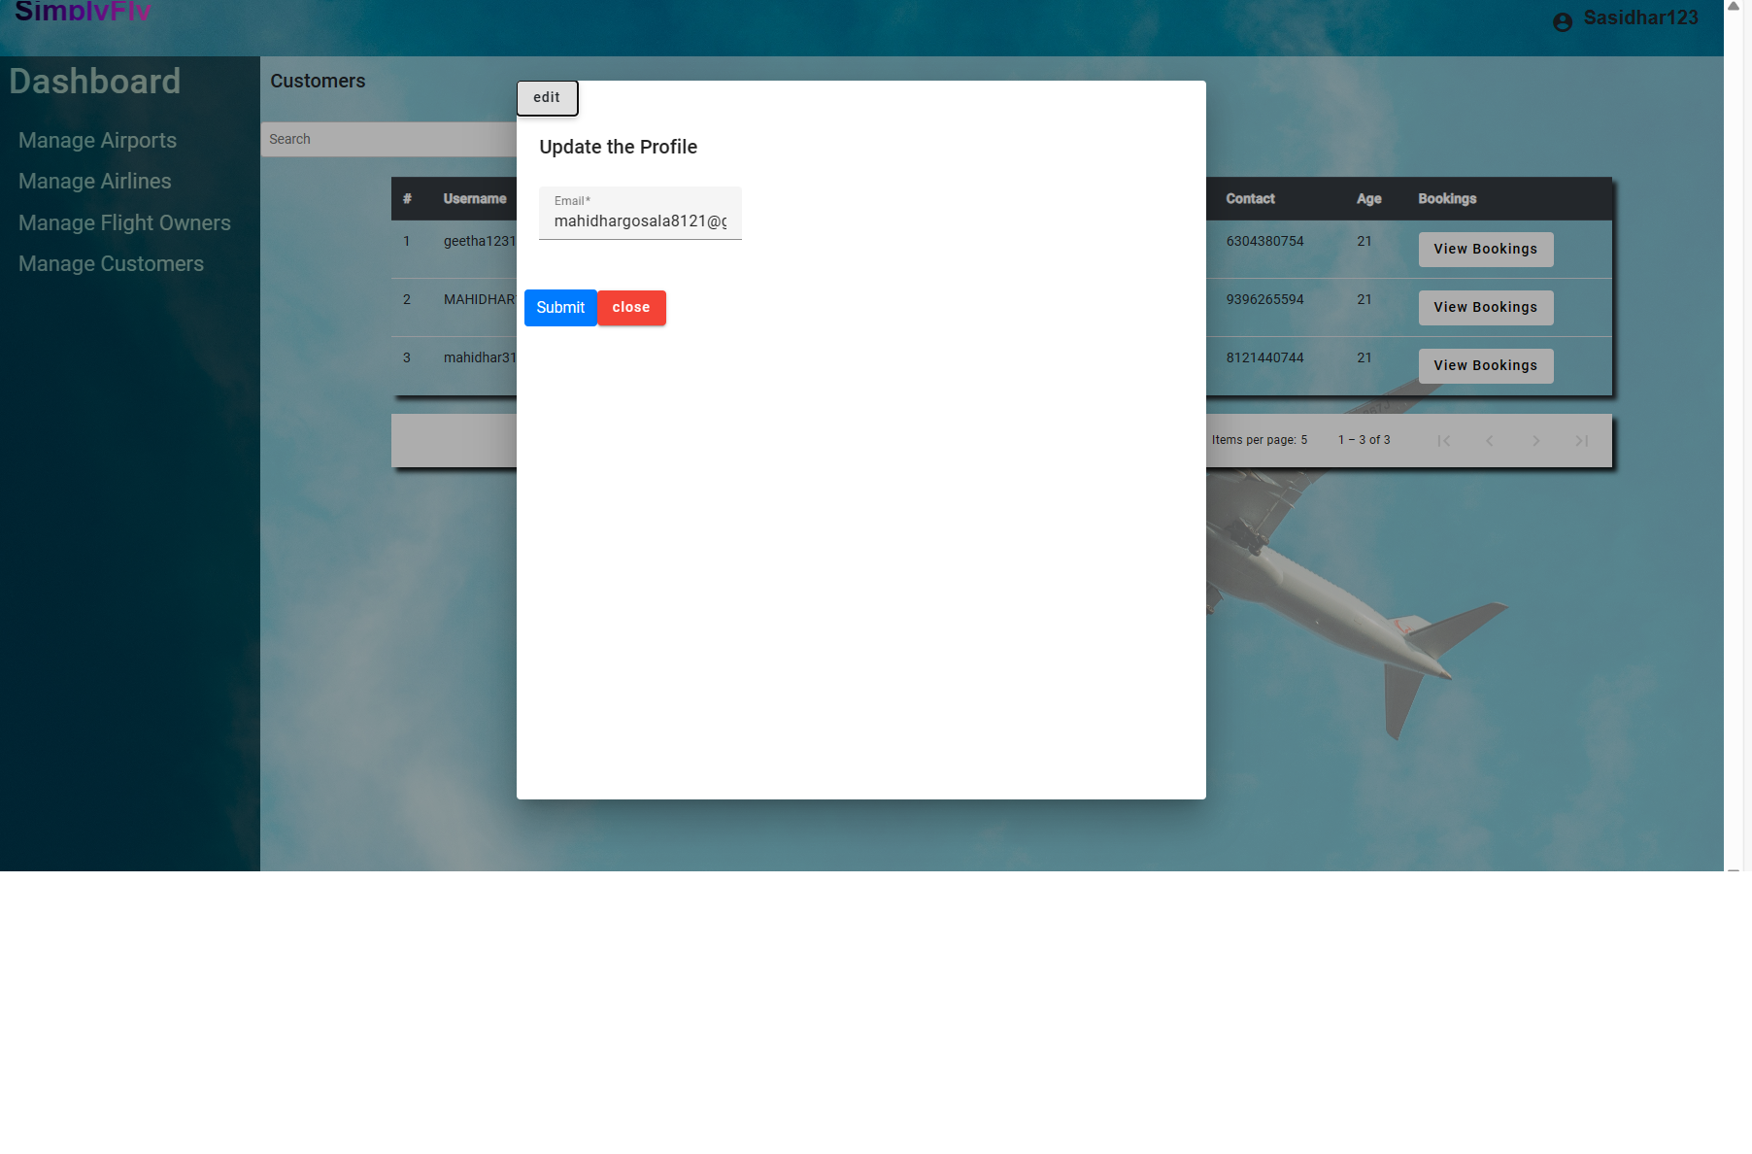
Admin Dashboard

Slide 10
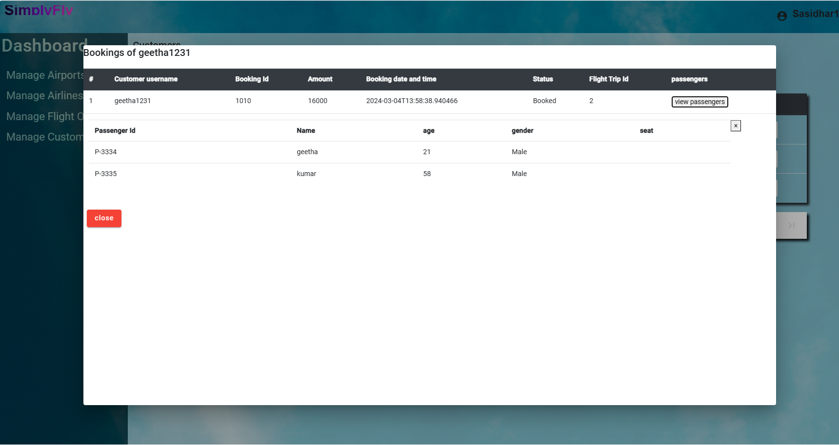
Admin Dashboard

Slide 11
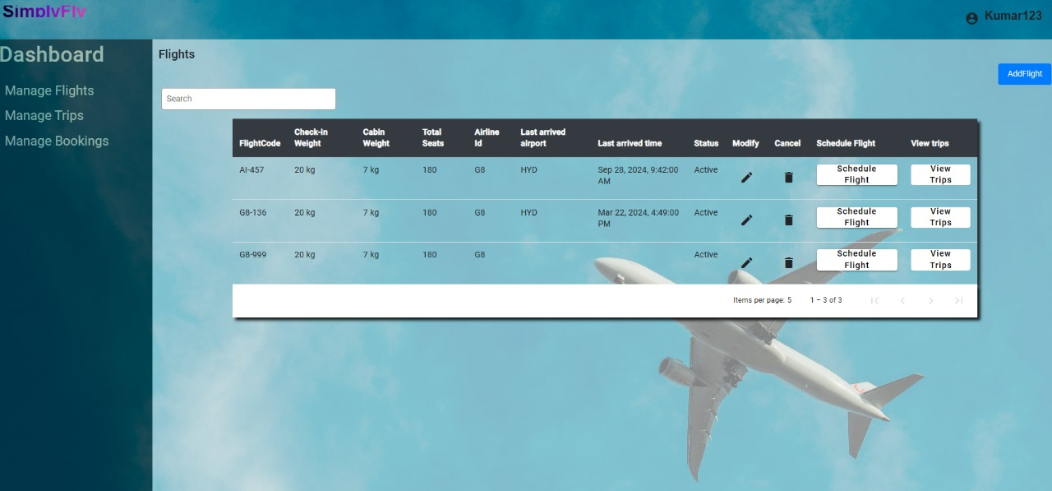
Flight Owner Dashboard

Slide 12
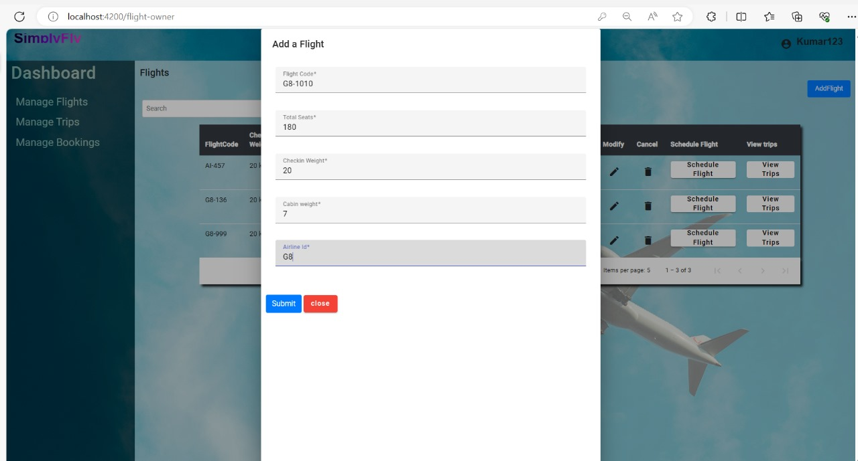
Flight Owner Dashboard

Slide 13
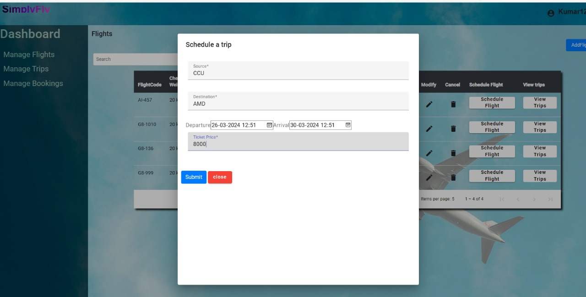
Flight Owner Dashboard

Slide 14
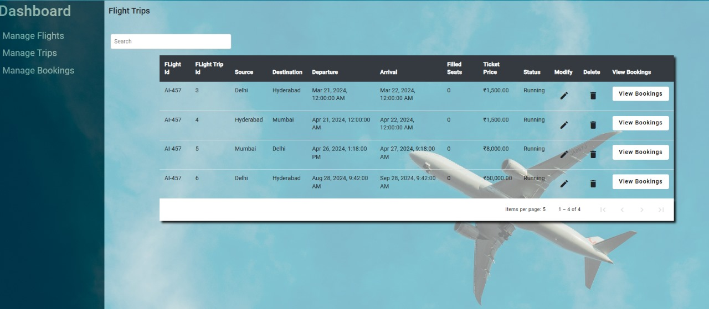
Flight Owner Dashboard

Slide 15
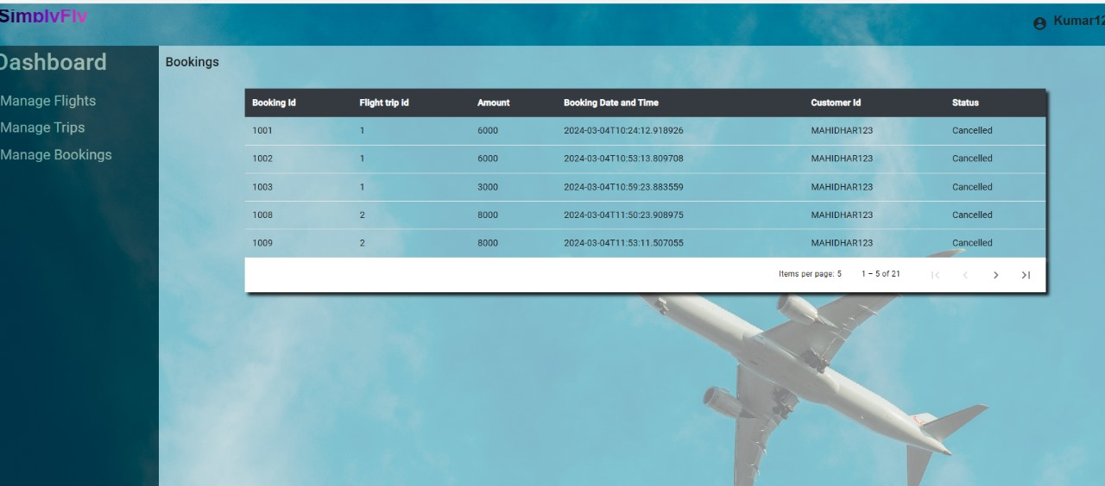
Flight Owner Dashboard

Slide 16
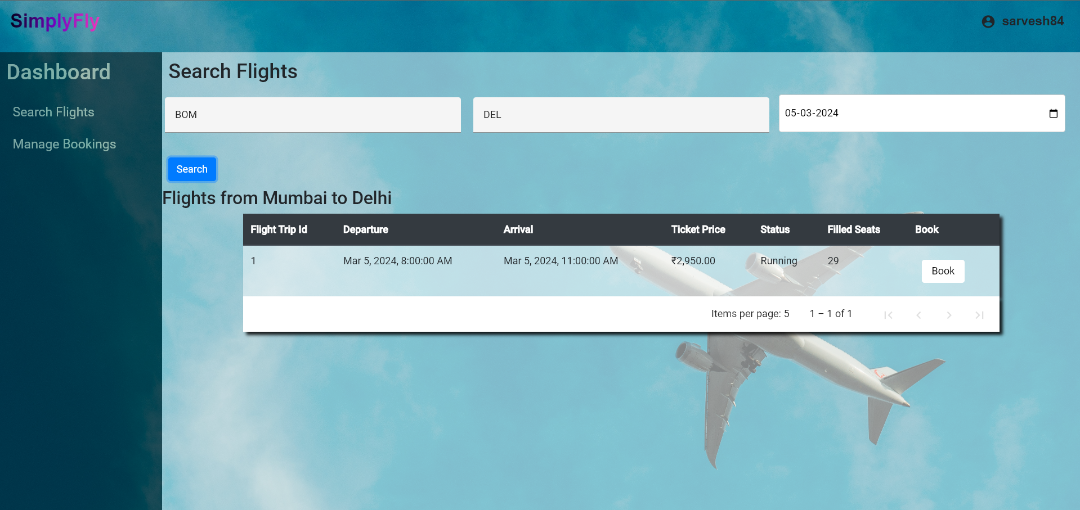
Customer Dashboard

Slide 17
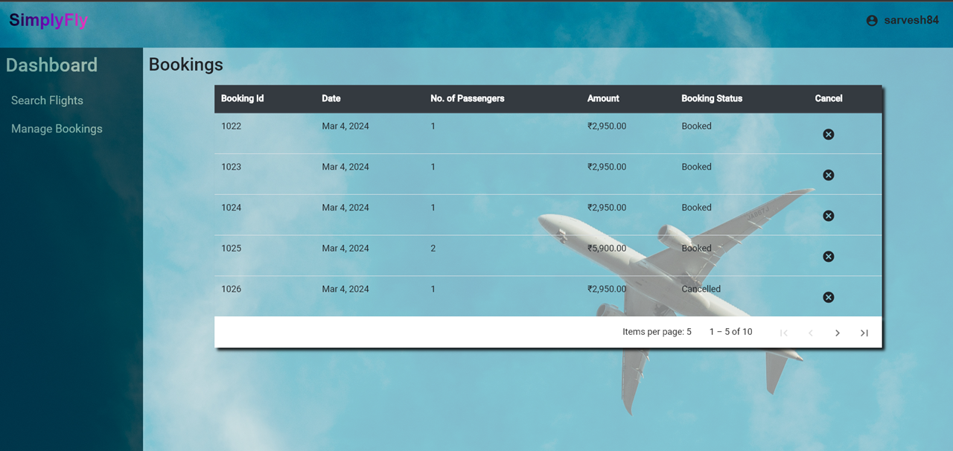
Customer Dashboard

Slide 18
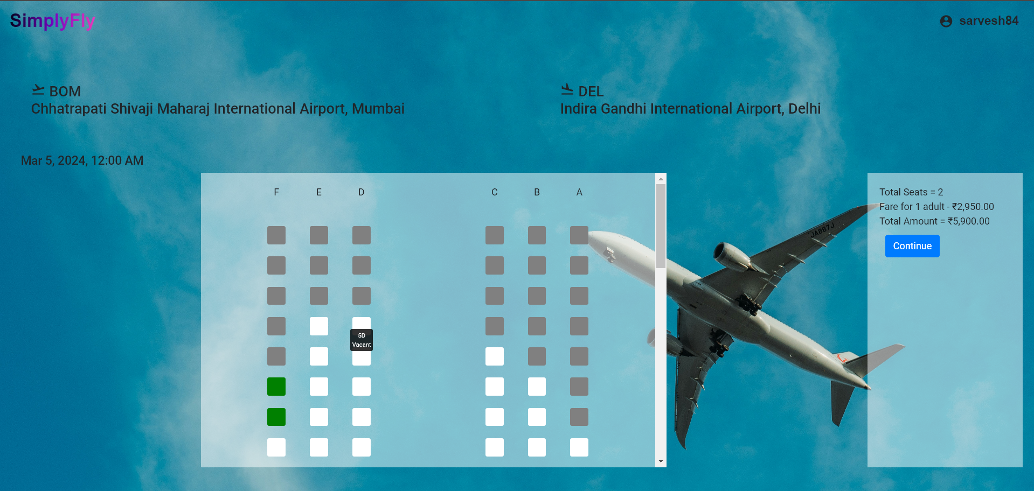
Customer Dashboard

Slide 19
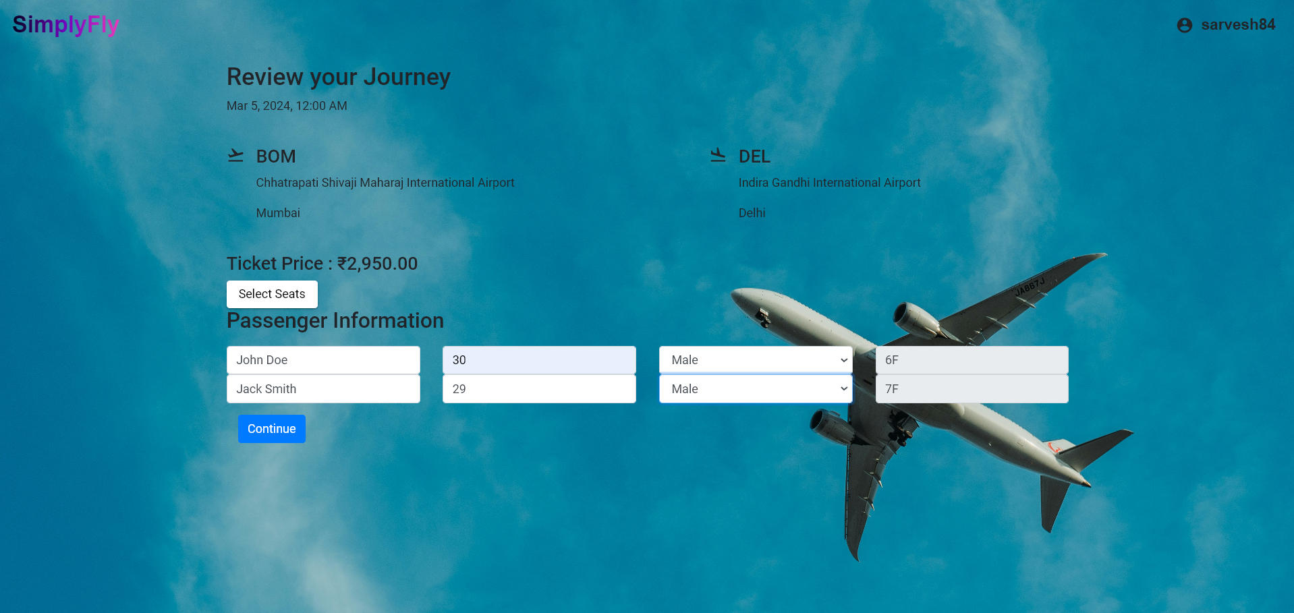
Customer Dashboard

Slide 20
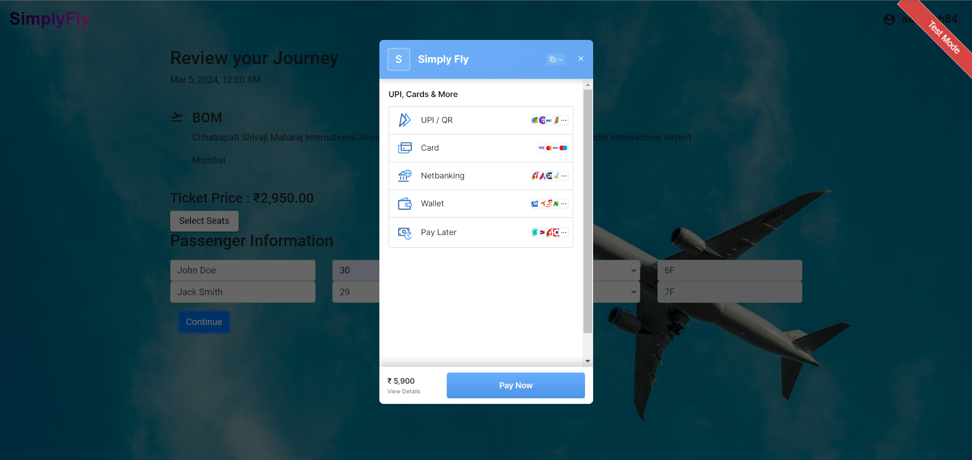
Customer Dashboard

Slide 21
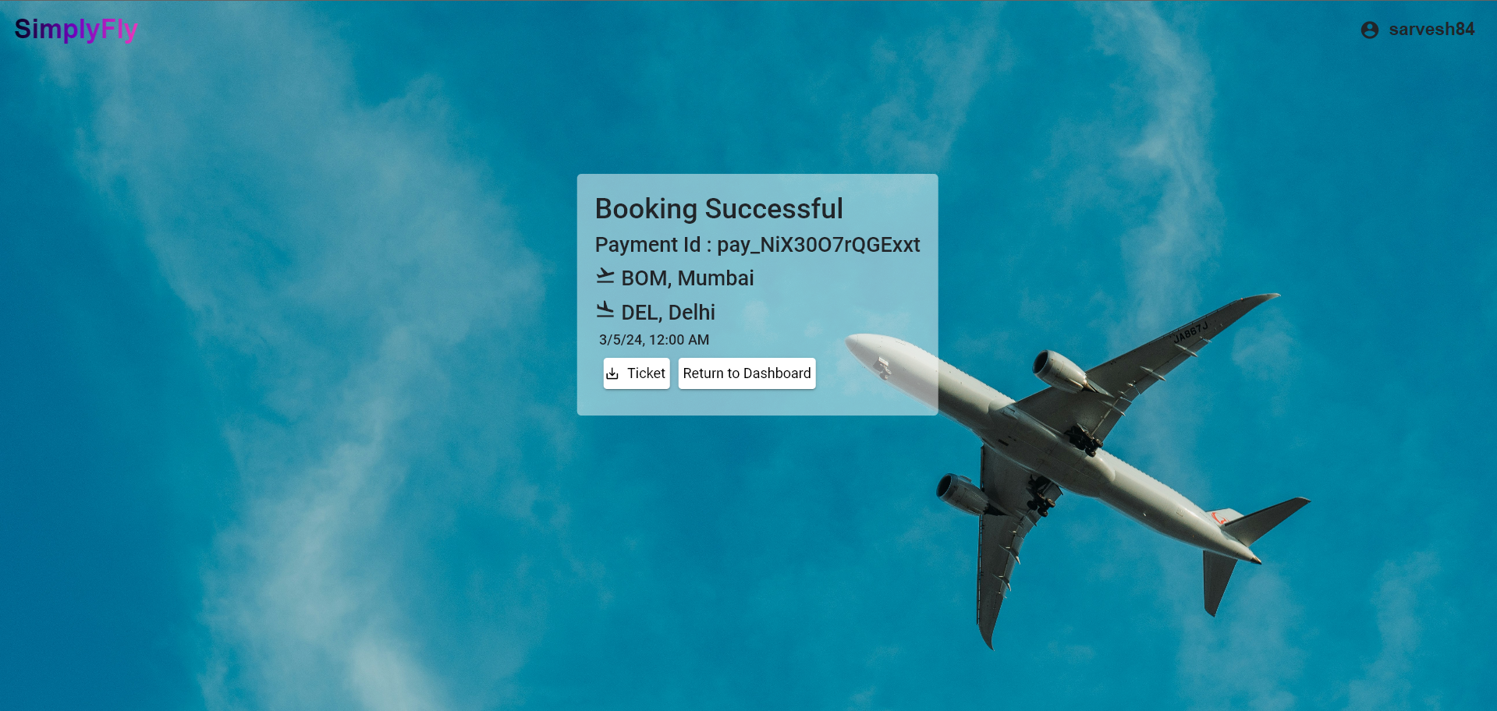
Customer Dashboard

Slide 22
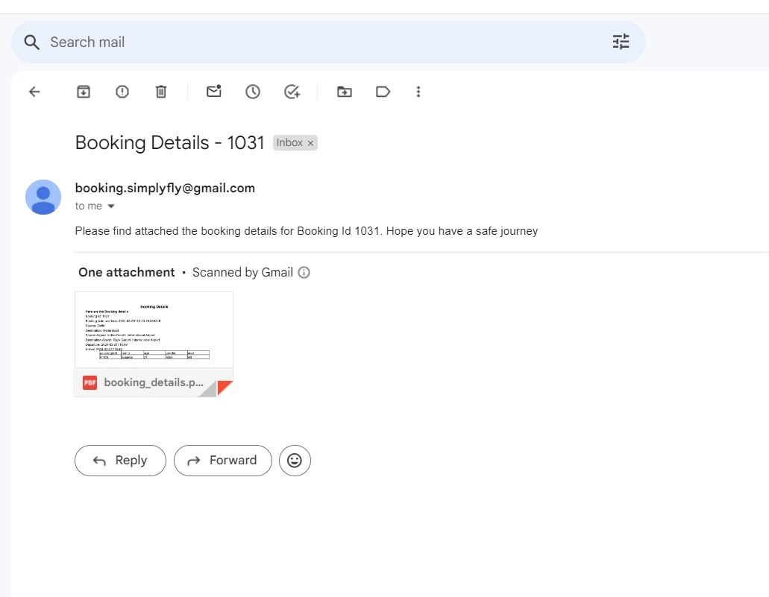
Customer Dashboard

Slide 23
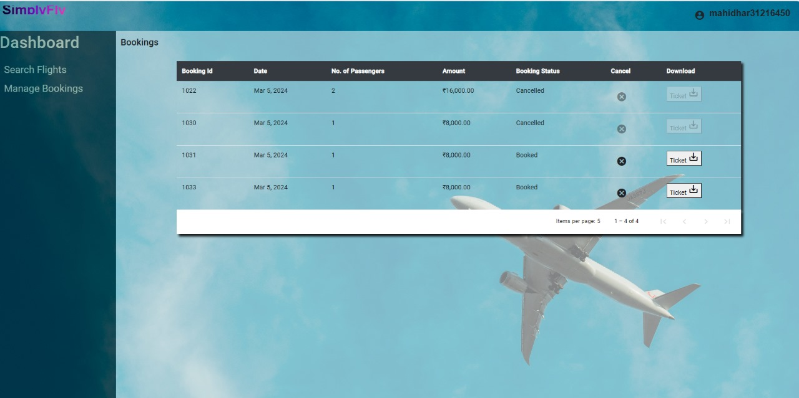
Customer Dashboard

